Slide 1
Market Analysis and Prediction Of Indian Stock Companies
Abhay Sharma 220341225001
Swarnim Vaidya 220341225055
PG DBDA March 22
Guided by:
Mr. Akshay Tilekar

Slide 2
Problem Statement
The stock value changes every minute based on buys and sells of stock in market.
As a technical investor, you would look at historical price patterns and form an opinion about market trends.
Accordingly, you will decide whether you want to buy the stock or sell it.
We have tried to predict the trend of Close value of Nifty 50 stock of NSE which can used to analyse and understand the trend of stock market

Slide 3
DataSet Description
The original dataset of Nifty 50 is csv file name as NIFTY_50__EQ__INDICES__NSE__MINUTE.csv available on Kaggle website.
The data size is of 370740 rows consisting of 6 columns namely timestamp, open, high, low, close and volume.
The dataset consists of per minute data from 9.15 am when NSE stock market opens to 3.29 pm when market closes. The data is from 20170102 09:15:00 am to 20210101 15:29:00 pm
Kaggle Data Link
https://www.kaggle.com/datasets/hk7797/stock-market-india

Slide 4
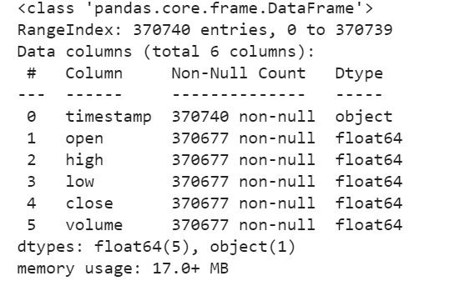
Screenshot of df.info()

Slide 5
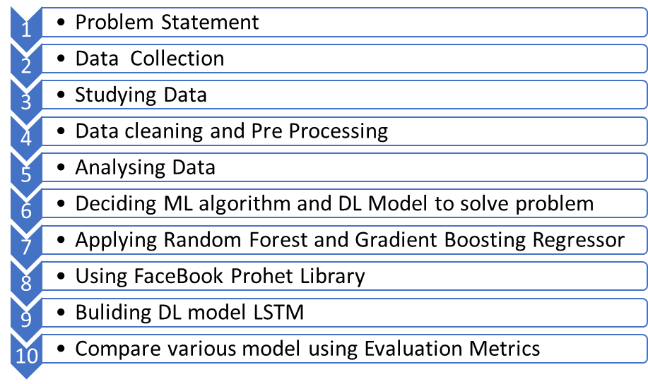
WorkFlow:

Slide 6
Data Cleaning & Preprocessing
Dataset has column timestamp having UTC+5:30 which was modified to remove +5:30
Timestamp was set as index to work with data as Time Series Data
Dataset was checked for null values
Null values were filled using ffill Pandas function
Dataframe constant of close column was created to predict trend of close value of Nifty 50 stock
Features were created for different algorithm using lag values

Slide 7
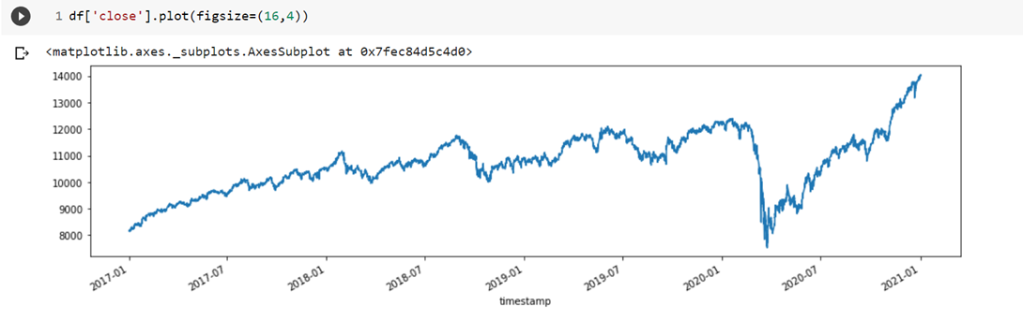
Data Analysis
Line Graph of close value of Nifty 50

Slide 8
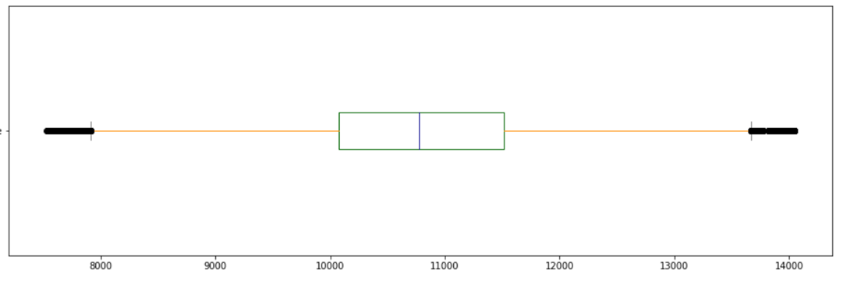
Boxplot
Q1 = Rs 10100
Q2 = Median value of Rs Rs 10900
Q3 = Rs 11600
IQR = Q3 Q1 = Rs 1500
Min Valid Value = Q1 -1.5 IQR = Rs 7850
Max Valid Value = Q3 + 1.5 IQR = Rs 13850
Outlier = value less than Rs 7850 and more than Rs 13850

Slide 9
Models Chosen
The dataset is complex per minute based time series which is explored & used to predict the trend of closing value of stock using historical values
We have used
Random Forest Regressor
Gradient Boosting Regressor
Facebook Prophet Library
DL model LSTM

Slide 10
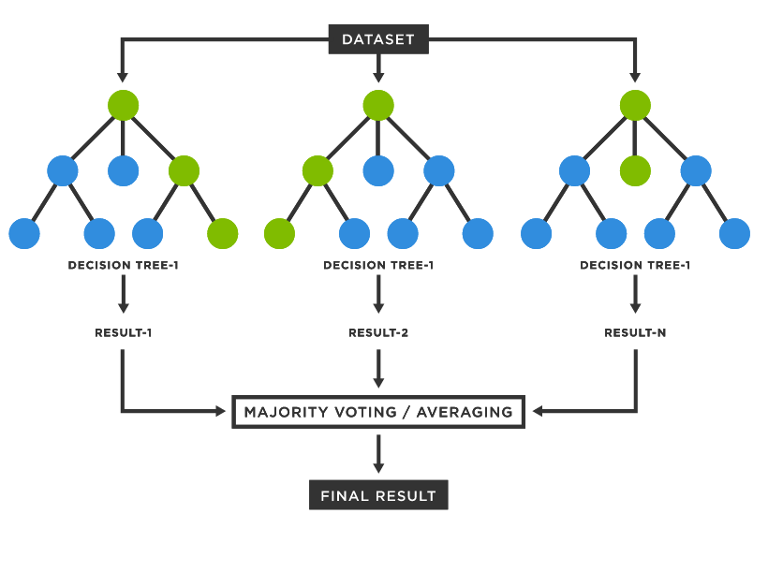
Random Forest Regressor
Since a random forest is an ensemble of decision trees, it has
Lower variance
High Accuracy
Strong Algorithm
Automates missing values
We have created 2 models of Random
Forest Regressor model namely Model 1 and
Model 3
Model 1 and Model 3 have different features size
And also features are created using different lag values
We have used GridSreach CV to fine tune the models

Slide 11
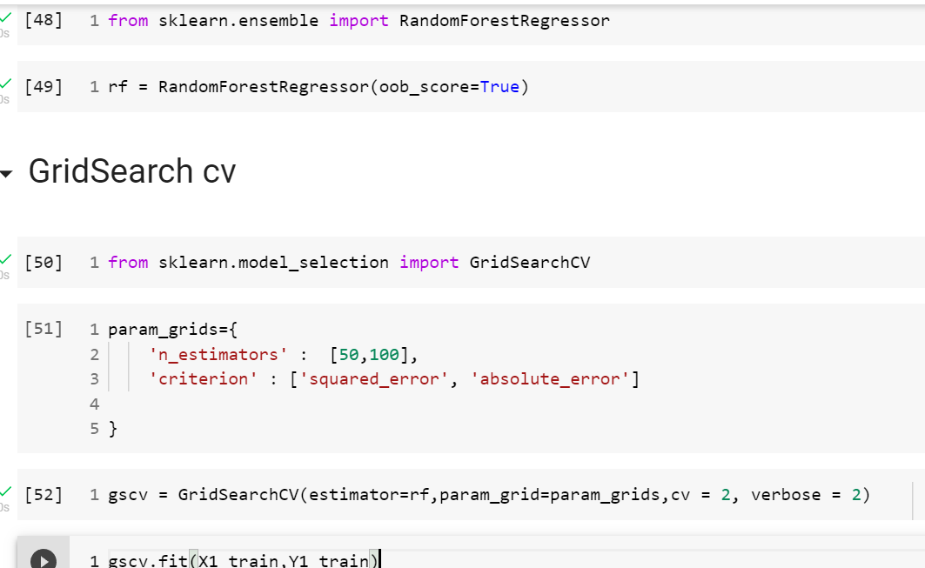
Screenshot of Random Forest Regressor

Slide 12
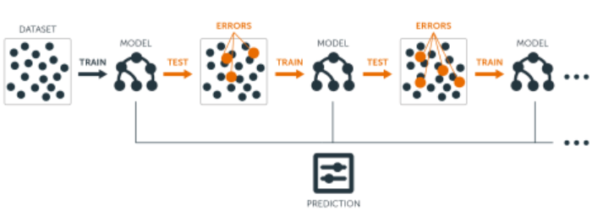
Gradient Boosting Regressor
It is Ensemble learning
give a more accurate prediction
It is much more flexible than other algorithms
It does not require data pre-processing because it is suitable for both numeric as well as categorical variables.
it handles missing data automatically.
We have created 2 models of Gradient Boosting Regressor namely Model 2 and Model 4
Model 2 and Model 4 have different feature size and feature are also created using different features
We have used GridSearchCV to fine tune the algorithm

Slide 13
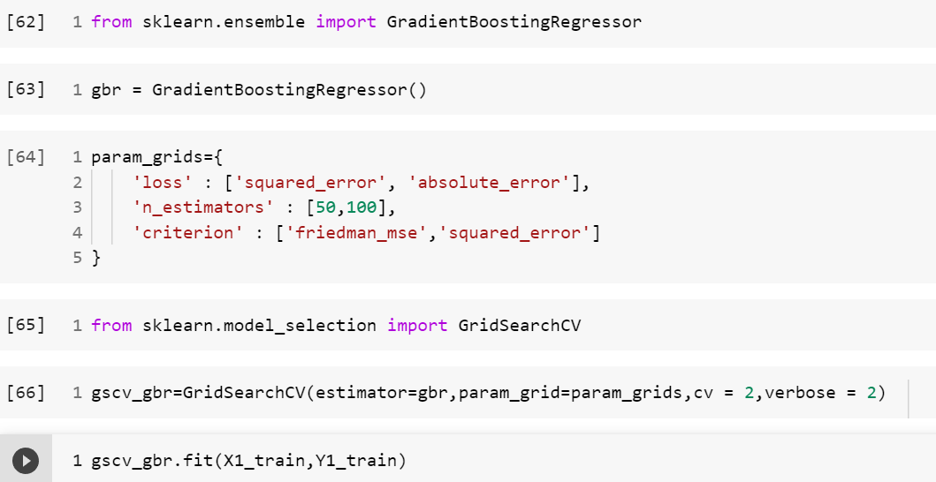
Screenshot of Gradient Boosting Regressor

Slide 14

Facebook Prophet
Made for Time Series.
Automatic and Fast.
Produces reliable and accurate models.
Handle missing values and outliers. Imputes the missing values.
Removes data points that deviate from the general dataset observations.
Handles seasonality and holiday effects.
It produces a tunable model.

Slide 15
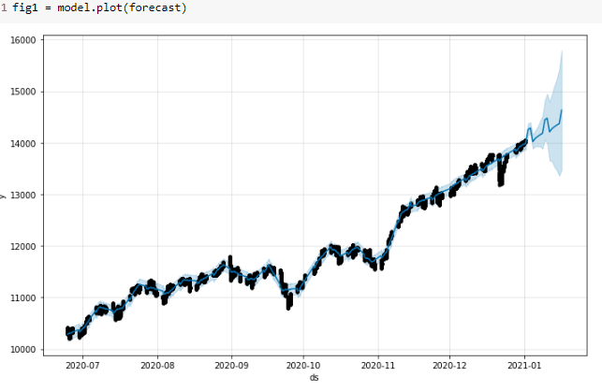
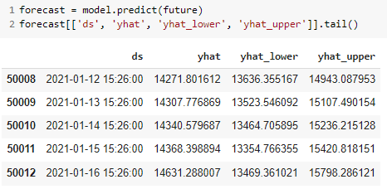


Slide 16
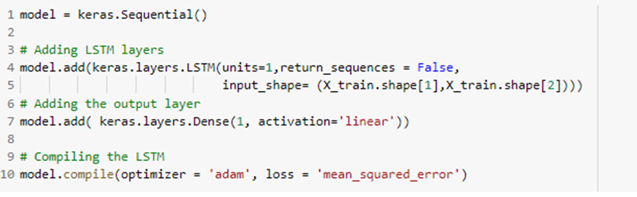
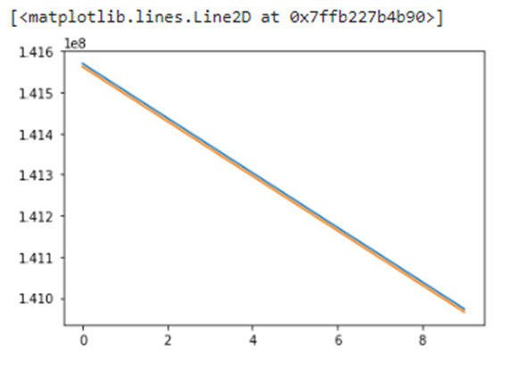
LSTM (Long Short Term Memory)
Using LSTM, time series forecasting models can predict future values based on previous, sequential data. This provides greater accuracy for demand forecasters which results in better decision making for the business.
We created 2 LSTM models here:
1st with just a Single neuron:

Slide 17
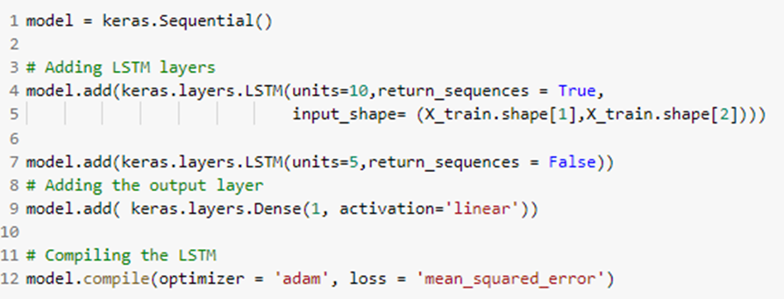
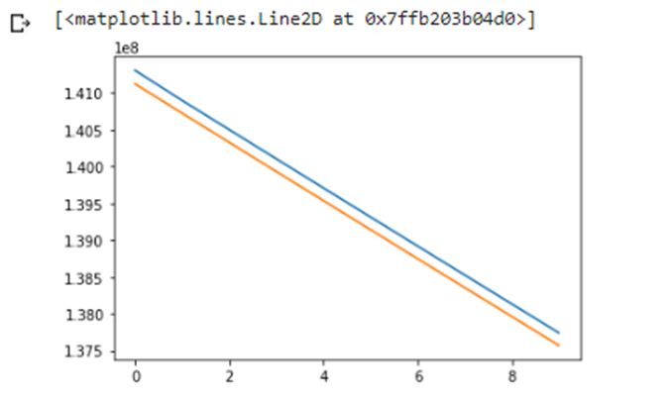
2nd Model consists of 10 neurons with 10 epochs:

Slide 18
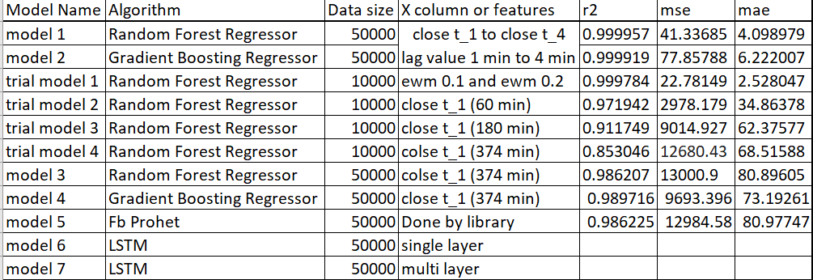
Compare Models
Following Table shows various models which can be compared using R2, MSE, MAE

Slide 19
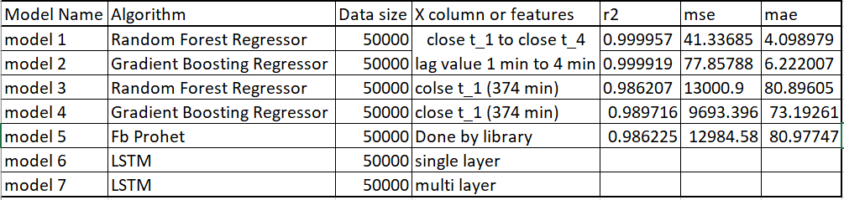
Conclusion
The models with 50000 rows are used to comparing evaluating parameters.Each model uses different algorithm and features to predict the trend the value of close column
Model 1 has max R2 and least mse and mae

Slide 20
Future Scope
Implement Pycaret Library - Pycaret Library is an open-source, low-code machine learning library in Python that automates machine learning workflows. It is an end-to-end machine learning and model management tool that exponentially speeds up the experiment cycle and makes you more productive.
Create a WebApp using Streamlit - It is an open source app framework in Python language. It helps us create web apps for data science and machine learning in a short time. It is compatible with major Python libraries such as scikit-learn, Keras, PyTorch, SymPy(latex), NumPy, pandas, Matplotlib etc.
Deployment on AWS and Heroku

Slide 21
References
Dataset on Kaggle website - https://www.kaggle.com/datasets/hk7797/stock-market-india
Krish Naik GitHub - https://github.com/krishnaik06/Live-Time-Series
Financial Domain concepts - https://corporatefinanceinstitute.com/resources/knowledge/trading-investing/exponentially-weighted-moving-average-ewma/
Pandas Docs - https://pandas.pydata.org/
Library Used - Sklearn, statsmodel, Keras Docs - https://keras.io/
Facebook Prophet Library - https://facebook.github.io/prophet/

